Slide 1
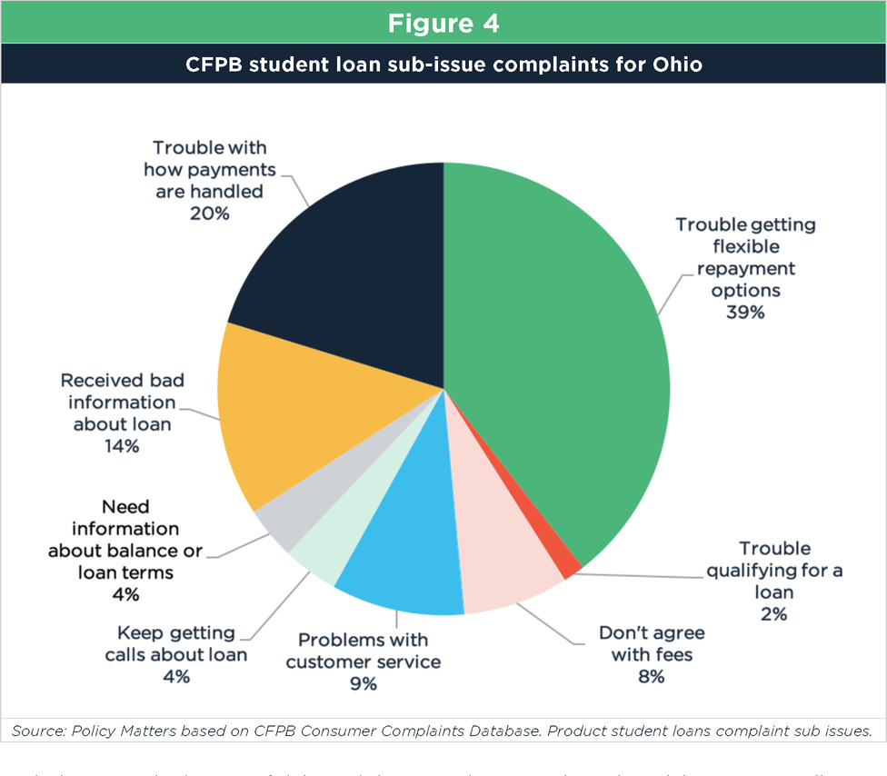
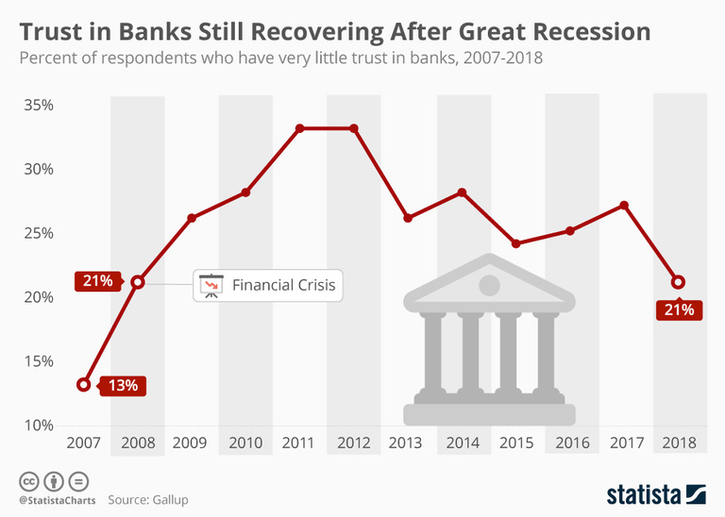
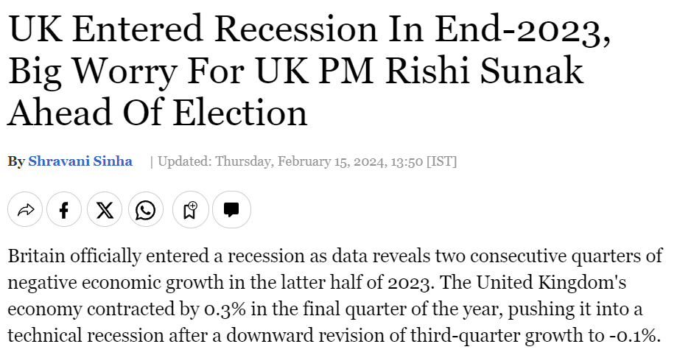
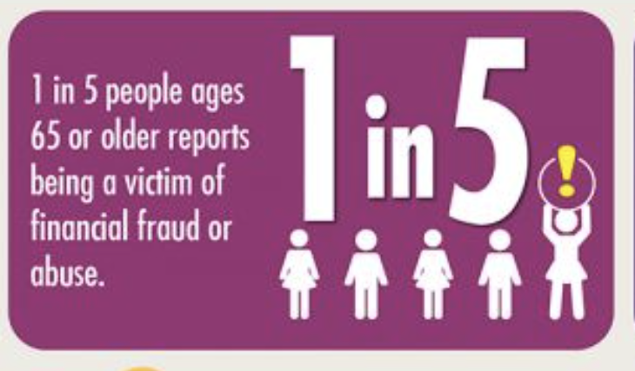
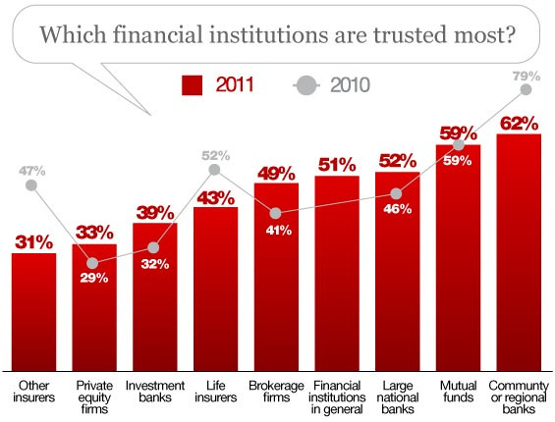
LendEase:
Community Driven Lending Platform

Slide 2





AGENDA
Research & Overview
Monetisation Strategy & Competition
1
2
3
4
5
Problem Statement
Technology
Growth Opportunities & Marketing

Slide 3
NEED FOR COMMUNITY-DRIVEN LENDING PLATFORM
High Interest Rates
Low Income
Low Credit Scores
COMMUNITY PROBLEMS
Emergency Loans
Understanding Needs
Trustworthy
Loans for Small Businesses
Unsustainable Debt Burdens

Slide 4
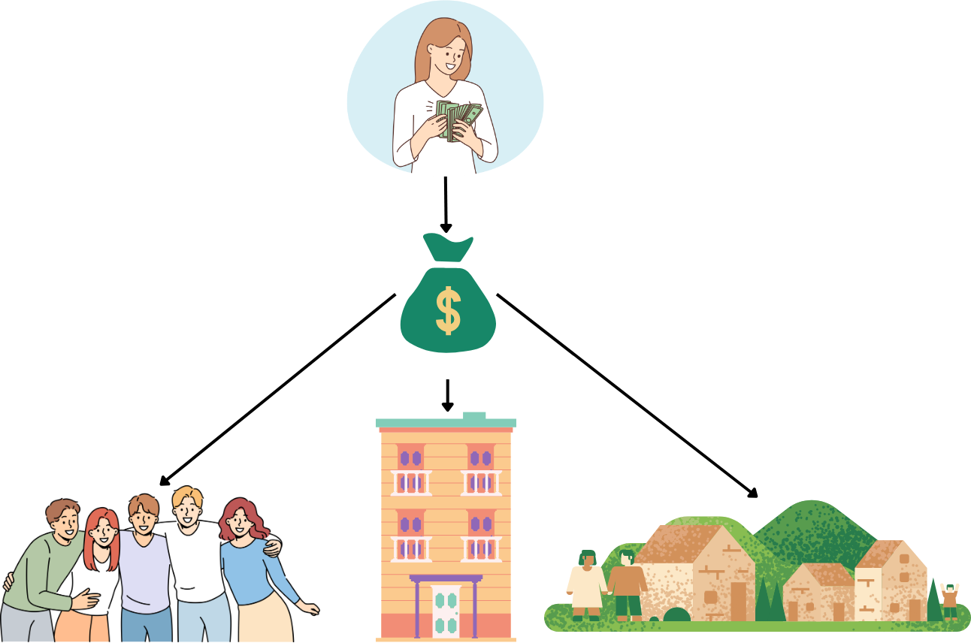
Say hello to community-driven money lending

Slide 5

Vision
Build a more equitable and inclusive financial system by harnessing technology to connect underserved communities with affordable and accessible loan options
Creating a better
future, together
Mission
Empower individuals and businesses by providing innovative lending solutions that foster local economic development and financial well-being
Target
Low-income families, micro-entrepreneurs, specific geographic areas and demographics (students, elderly)

Slide 6
Our Goals
Financial Model: Ensuring affordability and reinvestment of profits back into the community
Impact Measurement: We track and report key metrics to demonstrate the positive social and economic impact of our application on individuals, businesses, and the community
Scalability: We are committed to developing a scalable model that can expand to serve larger communities and replicate success in other regions.

Slide 7
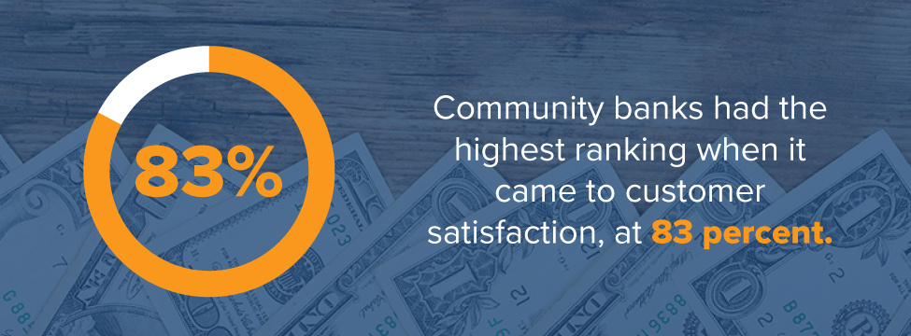
HTTPS://MIDPENNBANK.COM/FOUR-ADVANTAGES-COMMUNITY-BANK/

Slide 8
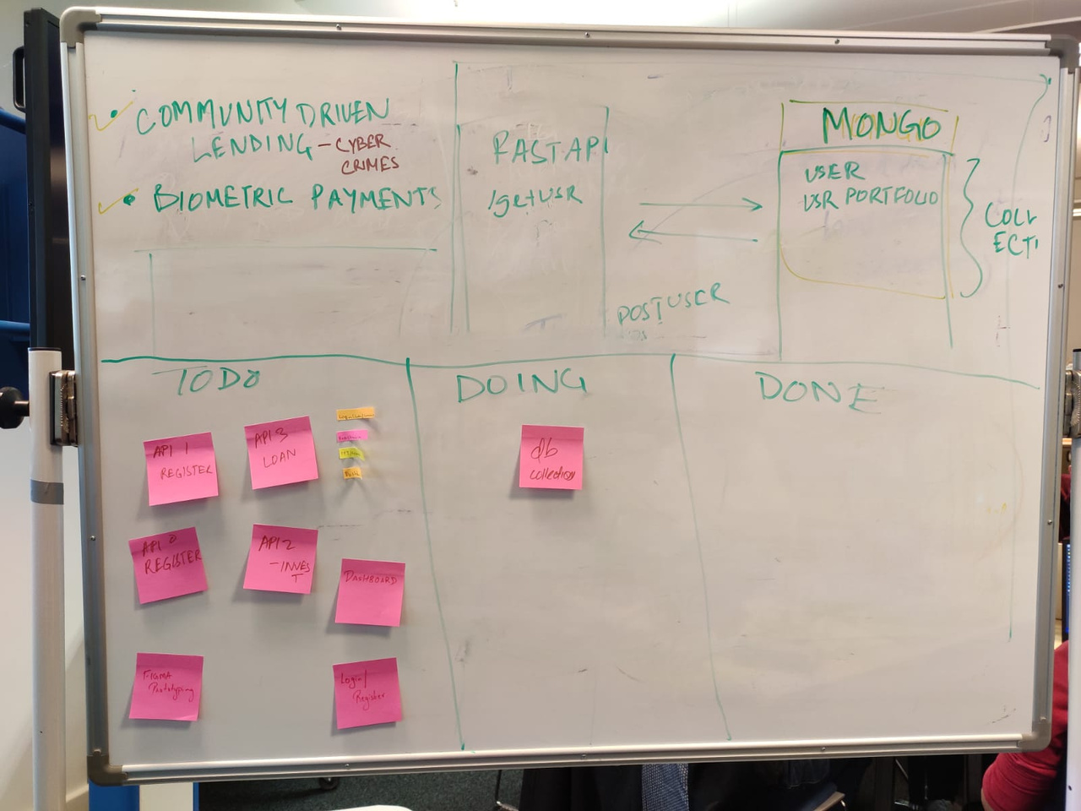
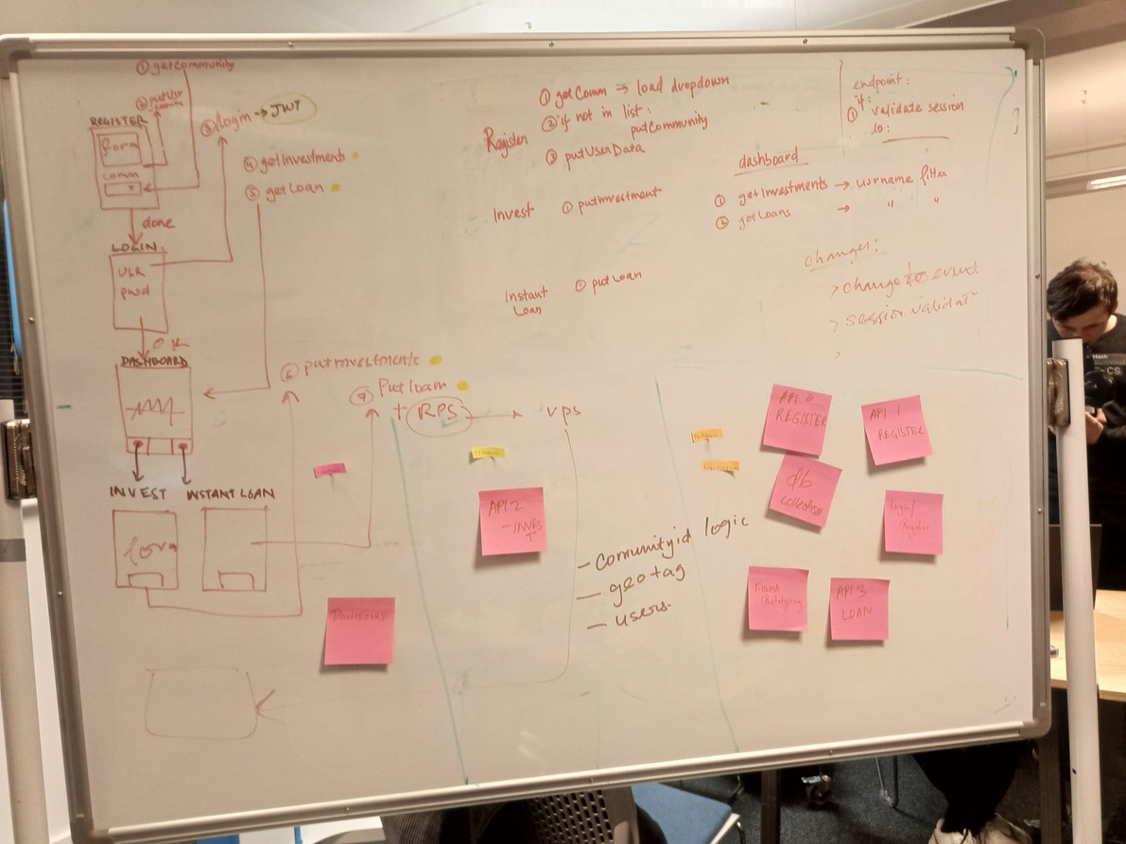
KANBAN BOARD

Slide 9

Business Model Canvas
v1
DATE : 18/02/2024
VERSION : V2
KEY PARTNERS
KEY ACTIVITIES
VALUE PROPOSITIONS
CUSTOMER RELATIONSHIP
CUSTOMER SEGMENTS
BIG LENDERS
PARTNERSHIP WITH
LARGE SCALE FIRMS
COMMUNAL POOL OF MONEY WHERE MEMBERS CAN BORROW
BIOMETRIC PAYMENTS
INCENTIVES
12% INTERESTS
LOW INTEREST RATES
NO COLLATERAL
FLEXIBLE BANKING
SECURE PAYMENTS
AWARENESS EVENTS
FREE PERSONAL FINANCE CONSULTATIONS
SMALL MARGINALISED COMMUNITIES
APARTMENTS
STUDENT COMMUNITITES
SOCIETIES AND CLUBS
CHANNEL
KEY RESOURCES
SOCIAL MEDIA
TV/NEWS PAPERS
WORD OF MOUTH
COMMUNITY MONEY POOL
SEED FUND
DATA FROM CUSTOMERS
COST STRUCTURE
REVENUE STREAM
SOCIETAL BENEFITS
SUBSCRIPTION BASED
DISCOUNTS FOR ELDERLY/NEW JOINEE/STUDENTS
SUBSCRIPTION BASED
REDUCE PREDATORY LOANS (TRUST BASED)
SAVES TIME IN CASE OF EMERGENCY
IMPROVES COMMUNAL WELLBEING

Slide 10
BENEFITS FOR LENDERS
BENEFITS FOR BORROWERS
LENDERS HAVE THE OPPORTUNITY TO EARN COMPETITIVE INTEREST RATES ON FUNDS LENT OUT, PROVIDING A SOURCE OF PASSIVE INCOME.
BY SUPPORTING FELLOW COMMUNITY MEMBERS IN THEIR FINANCIAL ENDEAVORS, LENDERS CONTRIBUTE TO THE OVERALL WELL-BEING AND STABILITY OF THE COMMUNITY.
BUILDING TRUST AND FOSTERING RELATIONSHIPS WITHIN THE COMMUNITY CAN LEAD TO LONG-TERM FINANCIAL OPPORTUNITIES AND SOCIAL CONNECTIONS.
BORROWERS GAIN ACCESS TO AFFORDABLE LOANS WITH LOWER INTEREST RATES COMPARED TO TRADITIONAL BANKS, ENABLING THEM TO ACHIEVE THEIR FINANCIAL GOALS MORE EFFECTIVELY.
OUR PLATFORM OFFERS A FASTER LOAN APPROVAL PROCESS WITHOUT STRINGENT COLLATERAL REQUIREMENTS, ENSURING GREATER ACCESSIBILITY FOR BORROWERS.
BORROWERS ALSO BENEFIT FROM FINANCIAL EDUCATION AND MENTORSHIP OPPORTUNITIES WITHIN THE COMMUNITY, EMPOWERING THEM TO MAKE INFORMED FINANCIAL DECISIONS.

Slide 11
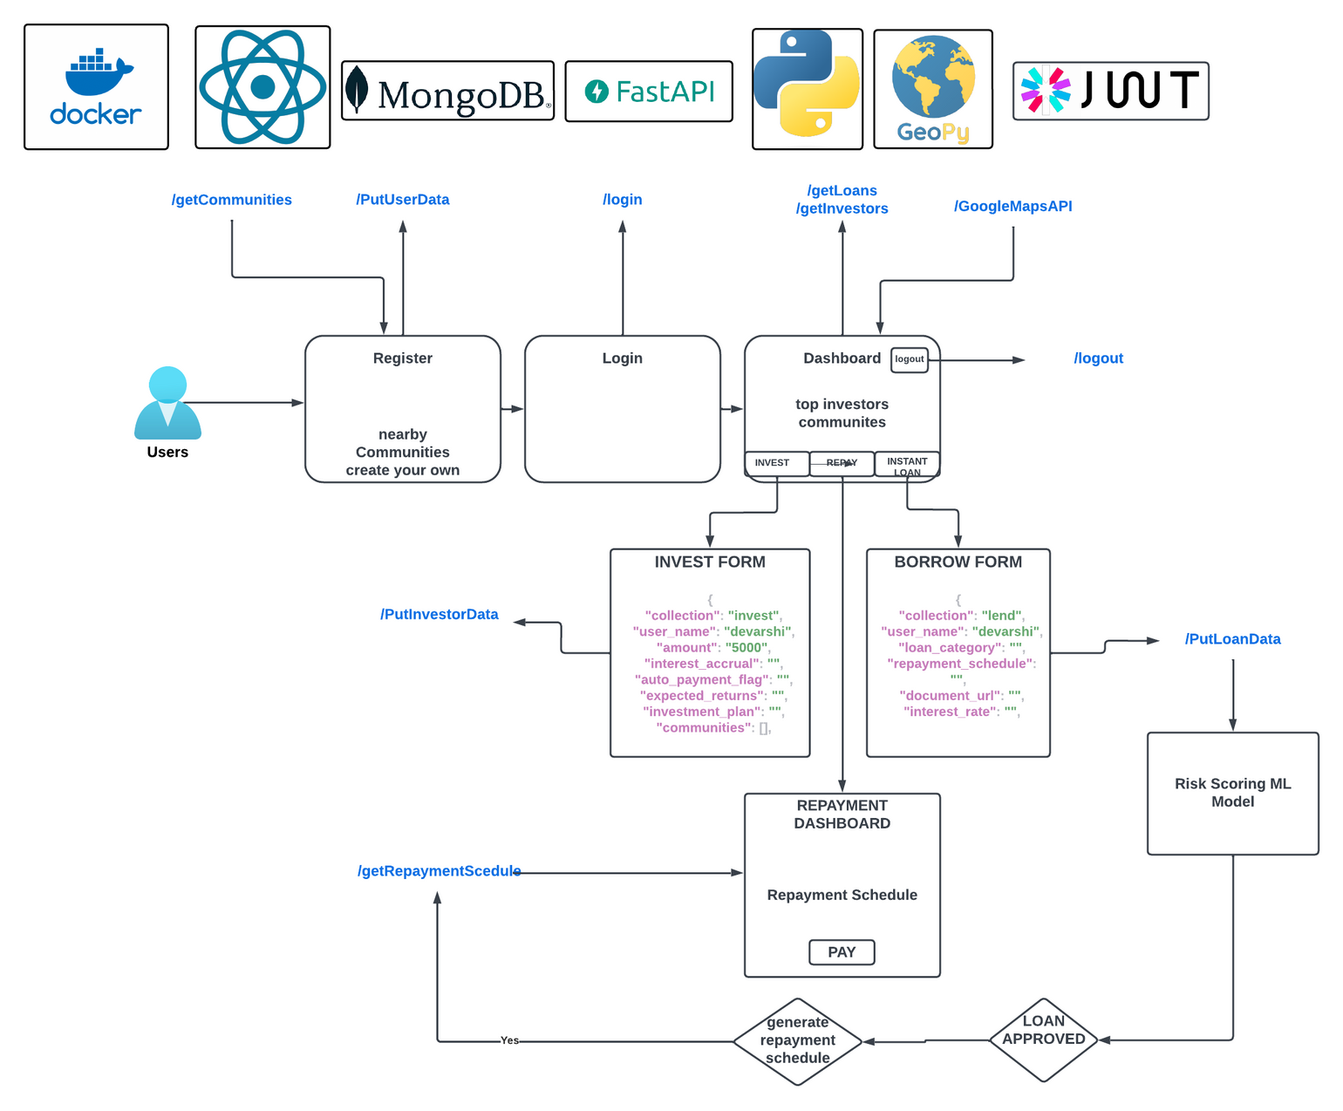
TECHNOLOGY STACK

Slide 12




PROMOTION
Advertising
Social Media
Direct Marketing
Event Marketing

Slide 13

TRANSPARENT
FEE STRUCTURE
PREMIUM
FEATURES
MONETISATION STRATEGIES &
COMPETITION
REINVEST
PROFITS
PARTNERSHIP
WITH
LARGE FIRMS
SUBSCRIPTION
MODEL

Slide 14


CHALLENGES
USED UP MONEY POOL
What if someone borrows all the money in the pool and it runs out?
MULTIPLE BORROWERS
REGULATIONS
What if multiple people request the same amount of money or the amount they borrow in total causes the pool to run out?
Who is the regulatory authority and what are legislations to consider?

Slide 15


Biometric payments: Biometric information of subscribers in a database connected to bank, which can be used for payments in local shops and trusted senders (without payment card, NFC).
Lending money through previous history and relationships built using ML: Emphasize relationship with the bank and the individual based on learning family histories, previous transaction history when making lending decisions.
FUTURE ROADMAP
Contact with credit scoring organisations and invoice financing: We could collaborate with credit scoring organisations to validate credit score before lending money and could then look into providing invoice quickly.

Slide 16
Our Goal - A Blend of Community-driven Lending, Secure Payments and Banking!

Slide 17
REFERENCES
FOUR ADVANTAGES OF BANKING WITH A COMMUNITY BANK | MID PENN BANK
STUDENT BORROWERS: PREY FOR PREDATORY LOAN SERVICERS (POLICYMATTERSOHIO.ORG)
INFOGRAPHIC: THE HIGH COST OF ELDER FINANCIAL ABUSE - ELDER PROTECTION CENTER
THE FUTURE OF COMMUNITY BANKS IN A GLOBAL ECONOMY | FINTECH MAGAZINE
TRUST IN LENDING (NBER.ORG)
WHY LENDING THROUGH COMMUNITY-BASED ORGANISATIONS MAKES SENSE (THECONVERSATION.COM)
CHART: TRUST IN BANKS STILL RECOVERING AFTER GREAT RECESSION | STATISTA
HOW YOU CAN REVERSE THE LOSS OF TRUST IN FINANCIAL INSTITUTIONS (THEFINANCIALBRAND.COM)

